Slide 1

WEB SERVICES
Aruna S
Department of
Computer Science and Engineering

Slide 2

WEB SERVICES
REST
S. Aruna
Department of Computer Science and Engineering

Slide 3
WEB SERVICES
REST
REST is acronym for REpresentational State Transfer
Architectural style for distributed hypermedia systems - Roy Fielding in 2000
History of REST - Prior to REST, developers used SOAP to integrate APIs. To make a call => XML document with a Remote Procedure Call (RPC) call in the body.
2000 – Roy Fielding
2000 – SalesForce – IAAS
2004 – Flickr
2006 – FaceBook, Twitter and AWS

Slide 4
WEB SERVICES
REST – Guiding Principles
Guiding Principles of REST
Client–server Architecture
Stateless
Cacheable
Uniform interface
Layered system
Code on demand (optional)

Slide 5
WEB SERVICES
REST – Technical Jargons
The key abstraction of information in REST is a resource
A resource may be: a document or image, a temporal service, a collection of other resources, a non-virtual object
The state of the resource at any particular timestamp is known as resource representation
Resource methods - GET/PUT/POST/DELETE (Not equal to HTTP methods)

Slide 6
WEB SERVICES
REST API
A RESTful API is based on REST architectural style and approach to communications often used in web services development.
REST API’s cloud consumers to expose and organize access to web services
RESTful APIs are used by such sites as Amazon, Google, LinkedIn and Twitter
A RESTful API breaks down a transaction to create a series of small modules.
Modularity provides developers with a lot of flexibility
It uses existing HTTP methodologies

Slide 7
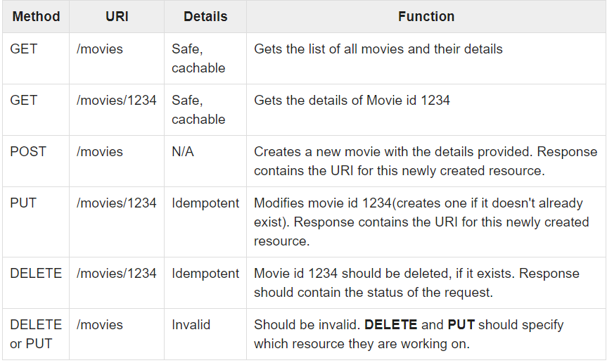
WEB SERVICES
REST API

Slide 8
WEB SERVICES
REST API – Advantages
Calls are stateless - Stateless components can be freely redeployed if something fails, and they can scale to accommodate load changes
The RESTful model is helpful in cloud services
Separation between the client and the server
Visibility, reliability and scalability.
The REST API is always independent of the type of platform or languages

Slide 9
THANK YOU
Aruna S
Department of
Computer Science and Engineering
arunas@pes.edu

